Slide 1

TITLE
Employee Data Analysis Using Excel.
JAYASREE P.S
B.COM (GENERAL)
3rd- year

Slide 2
INTRODUCTION OF DATA ANALYSIS:
Data analysis involves inspecting, cleaning, transforming, and modeling data to uncover useful information, draw conclusions, and support decision-making.
KEY STEPS :
Data collection
Data cleaning
Data exploration
Data modeling
Interpretation
Communication.

Slide 3
Components :
Components of the data analytics
A Clear Vision And Strategy
Prioritize strategic Business Opportunities
Data identification
Data qualification
Extract the Insights
Define and Execute the Outcome

Slide 4
Importance of data analysis :
1. Decision making.
2.Resource optimization
3.Risk management
4.Performance evaluation
5.Customer insights

Slide 5
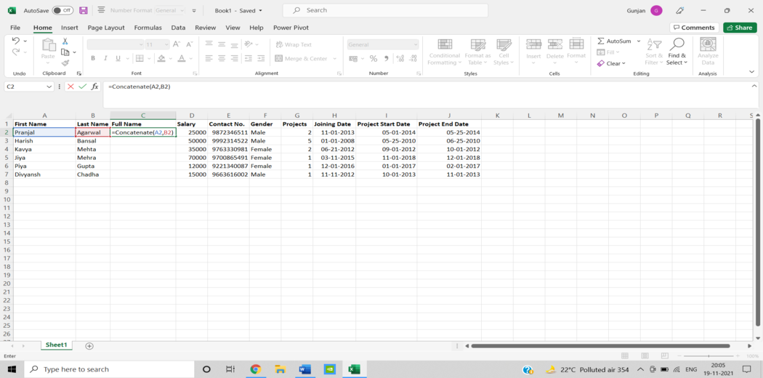
ESSENTIAL EXCEL DATA ANALYSIS FUNCTIONS
1. CONCATENATE
When conducting data analysis, the formula =CONCATENATE is one of the simplest to understand but most powerful. It allows text, numbers, dates, and other data from numerous cells to be combined into a single cell.
SYNTAX = CONCATENATE (text1, text2, [text3], …)

Slide 6
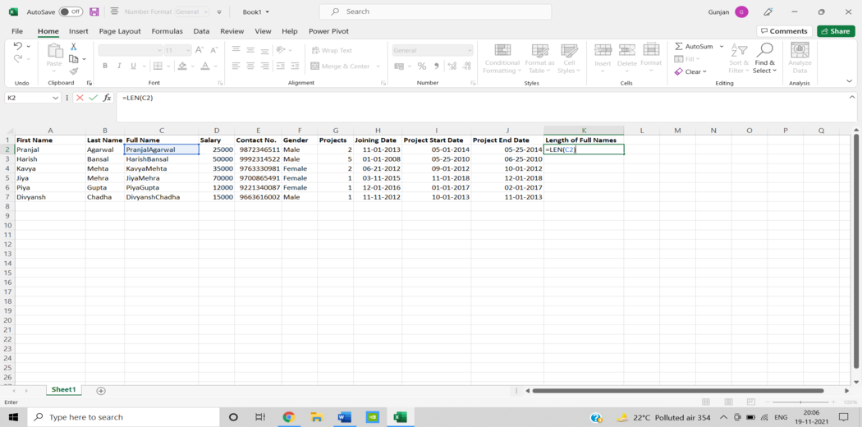
2. LEN ()
In data analysis, LEN shows the number of characters in each cell. It’s frequently used when working with text that has a character limit or when attempting to distinguish between product numbers.
SYNTAX = LEN (text)

Slide 7
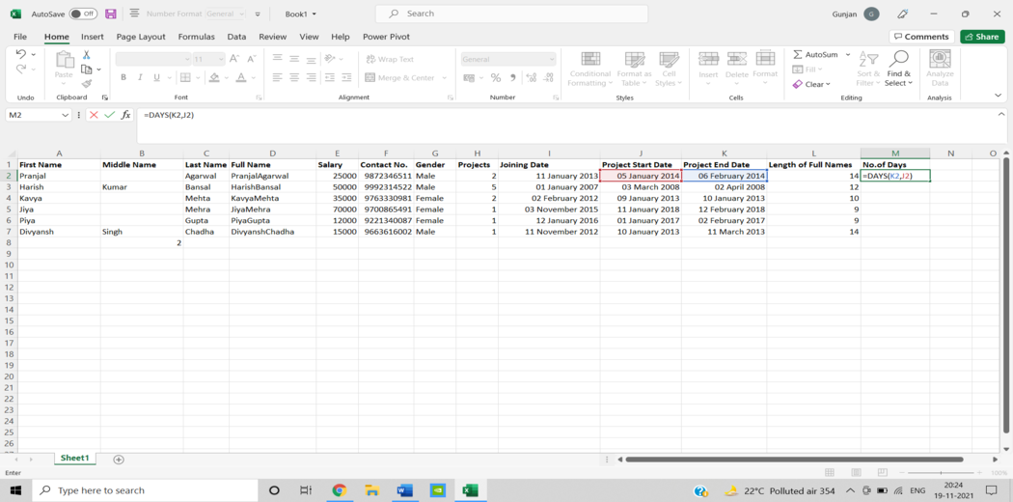
3. DAYS ()
The number of calendar days between two dates is calculated using this function = DAYS.
SYNTAX =DAYS (end_date, start_date)

Slide 8
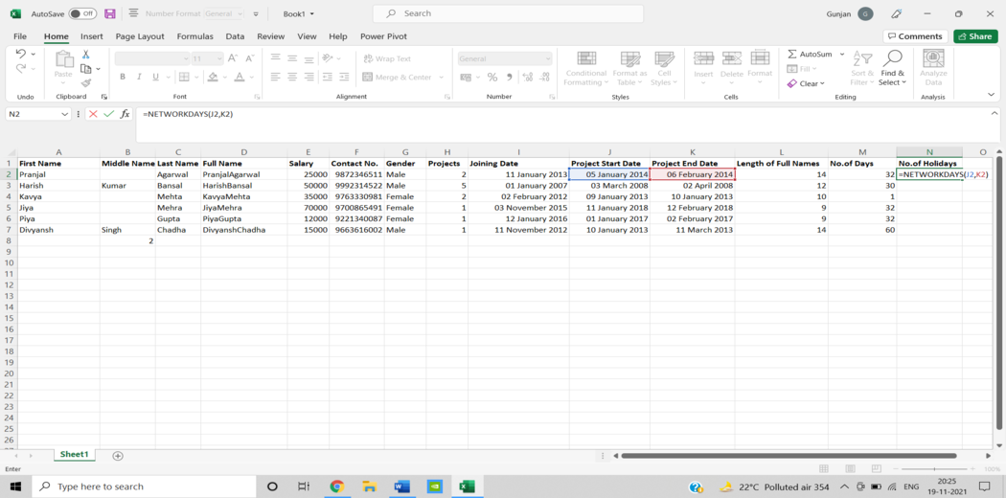
4. NETWORKDAYS
The number of weekends is automatically excluded when using the function. It’s classified as a Date/Time Function in Excel. The net workday function is used in finance and accounting to determine employee benefits based on days worked, the number of working days available throughout a project, or the number of business days required to resolve a customer problem, among other things.
SYNTAX = NETWORKDAYS (start_date, end_date, [holidays])

Slide 9
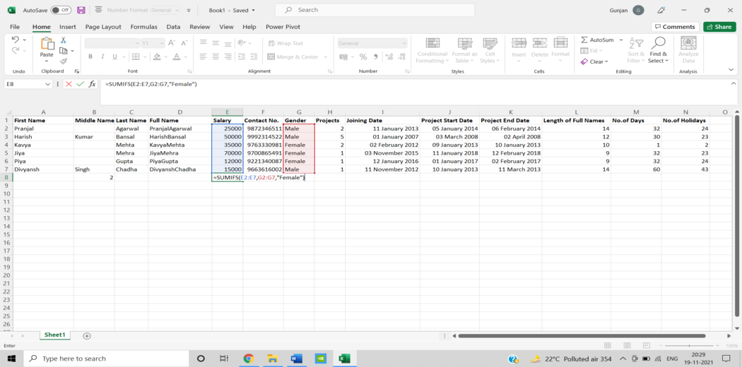
5. SUMIFS()
One of the “must-know” formulas for a data analyst is =SUMIFS. =SUM is a familiar formula, but what if you need to sum data based on numerous criteria? It’s SUMIFS.
SYNTAX = SUMIFS (sum_range, range1, criteria1, [range2], [criteria2], …)

Slide 10
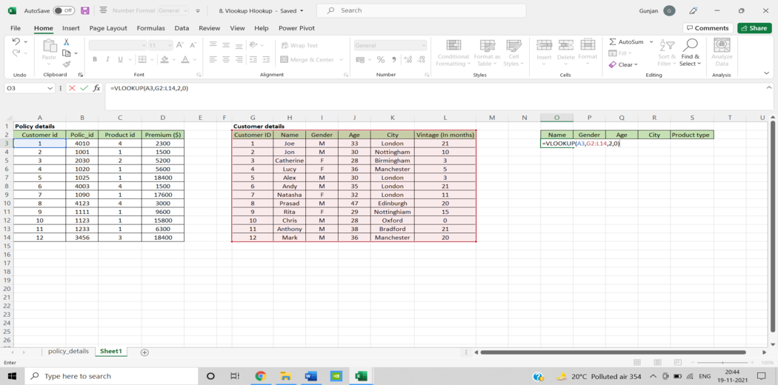
9.VLOOKUP()
The acronym VLOOKUP stands for ‘Vertical Lookup.’ It’s a function that tells Excel to look for a specific value in a column (the so-called ‘table array’) to return a value from another column in the same row.
SYNTAX = VLOOKUP (lookup_value, table_array, column_index_num, [range_lookup])

Slide 11
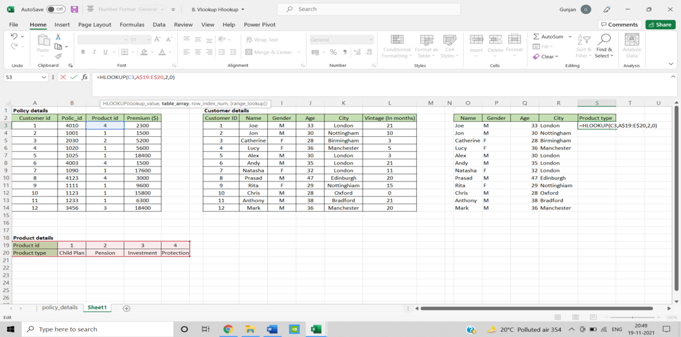
10. HLOOKUP()
“Horizontal” is represented by the letter H in HLOOKUP. It looks for a value in the top row of a table or an array of values, then returns a value from a row you specify in the table or array in the same column. When your comparison values are in a row across the top of a data table, and you wish to look down a specific number of rows, use HLOOKUP. When your comparison values are in a column to the left of the data you wish to find, use VLOOKUP.
SYNTAX = HLOOKUP (lookup_value, table_array, row_index, [range_lookup])

Slide 12
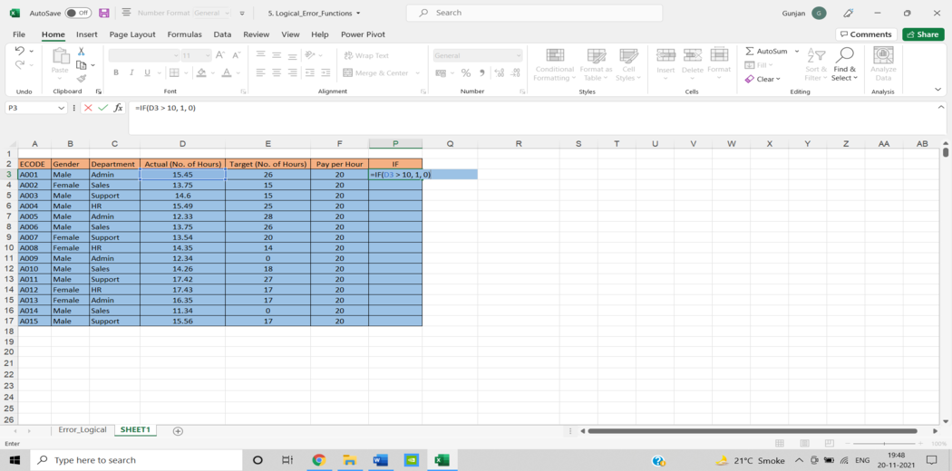
11. IF ()
The IF function comes in handy a lot. We can use this function to automate decision-making in our spreadsheets. We could use IF to make Excel conduct a different computation or show a different value based on the results of a logical test (a decision). The IF function will ask you to run a logical test and tell you what action to take if the test is true and what action to take if the test is false.
SYNTAX = IF (logical_test, [value_if_true], [value_if_false])

Slide 13
THE END

